Slide 1


Investigating Airbnb activity in Berlin, Germany
BAN 620: DATA MINING (GROUP 5 ) FINAL PROJECT

Slide 2
PROCESS FOLLOWED
Data COllection
Data Cleaning
Limitations
Data Modelling
Evaluate Results
Conclusion
Data Exploration
Feature Engineering
PREPARE DATA
ANALYZE DATA

Slide 3
Background Information
/
Airbnb, Inc.. , is an American online marketplace and hospitality service brokerage company based in San Francisco, California, United States.
The company does not own any of the real estate listings, nor does it host events; it acts as a broker, receiving commissions from each booking. (Source Wikipedia)
It is a popular online company where property owners (known as “hosts”) can rent their spaces.
A host must decide what price to charge for his or her space.
We have taken Airbnb Berlin data with over 22,552 listings as of Nov 2018. Viewing data, this is clearly a supervised Data Mining problem.

Slide 4
Data insights
We have considered Listing Summary dataset, which includes some of the below:
The dataset is of Nov 2018 and contains 96 attributes. Each listing is having a listing ID and name which are unique, host_ID and host_name gives the information about the host (owner of property).
Room_type, minimum_nights, maximum nights, latitude, longitude, neighbourhood_group and price are certain attributes explaining about properties type, min/max required time that property should be rented and location respectively.
There are few attributes which explains the frequency of a property being reviewed (reviews_per_month, number_of_reviews).
Weekly price & monthly price gives us the variation in price. While the review summary dataset contains reviewer_id, reviewer_name and comments i.e. all activity performed by reviewers/visitor information.
With keeping the data in mind, we investigate the below question:

Slide 5

Data Collection
"
DATA SOURCE:
Kaggle. Listings summary dataset having 22552 observations and 96 Variables
VARIABLES SELECTION:
We removed 63 variables as they were irrelevant for our analysis, below are few:
listing_url - interesting if we want to analyse the pictures as well but out of scope otherwise
scrape_id - same for all the records
name - textual description already extracted as continuos variables in other columns
notes - requires lot of preprocessing to turn into useful a feature
transit - requires lot of preprocessing to turn into useful a feature
calendar_updated - we are not interested in future data that is a subject to daily updates
jurisdiction_names - contains only nulls
is_business_travel_ready - contains one value of f

Slide 6
Data selected for preprocessing
id | Latitude | bedrooms | extra_people
host_response_time | longitude | beds | minimum_nights
host_response_rate | is_location_exact | bed_type | maximum_night
host_is_superhost | property_type | amenities | availability_365
host_neighbourhood | room_type | price | number_of_reviews
host_listings_count | neighbourhood_group_cleansed | security_deposit | review_scores_rating
host_has_profile_pic | accommodates | cleaning_fee | instant_bookable
host_identity_verified | bathrooms | guests_included | cancellation_policy

Slide 7

Data Cleaning
After removing the irrelevant variables, we were left with 33 variables, on which we did some preprocessing as below
Replacing NA values with Null
Replaced Zero with NA in price variables such as security_deposit, cleaning_fee, extra_people.
Check for missing data
Here, we found certain variables with a lot of missing values and NA, hence we dropped those variables
Removed NA values from few variables as NA are of no use
Price, security_deposit, cleaning_fee, extra_people were converted into numerical type

Slide 8
Variables after removing Null values & NA
Latitude | bedrooms | extra_people
longitude | beds | minimum_nights
is_location_exact | bed_type | maximum_night
property_type | amenities | availability_365
room_type | price | number_of_reviews
neighbourhood_group_cleansed | security_deposit | id
accommodates | cleaning_fee | instant_bookable
bathrooms | guests_included | cancellation_policy

Slide 9
LIMITATIONS
Day and date of the year of Berlin listings is not given in theb. So, can’t take seasonality or weekends and weekdays into account
Price has been taken at a single point of time, i.e. for a specific day
Size of the apartments is not available

Slide 10
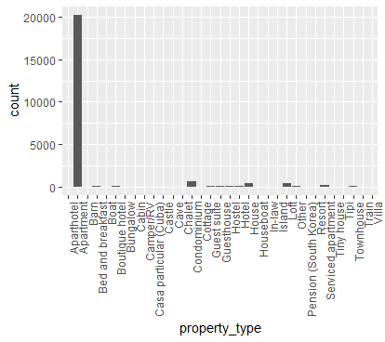
Number of each property type of the listings: Majority is Apartments, thus we drop this variable.

Slide 11
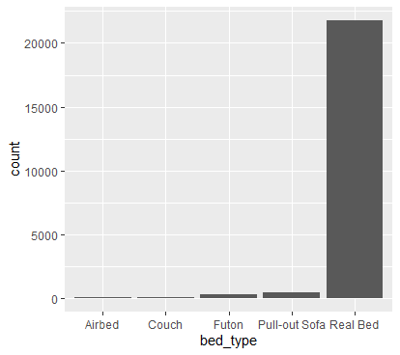
Number of each bed type of the listings: Majority is Real bed, thus we drop this variable.

Slide 12
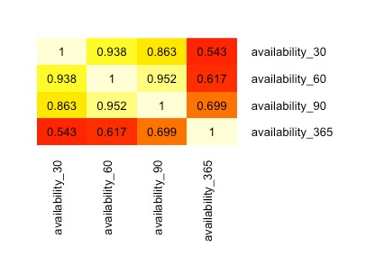
Heat Map showing the correlation between availability variables

Slide 13

Data Exploration

Slide 14
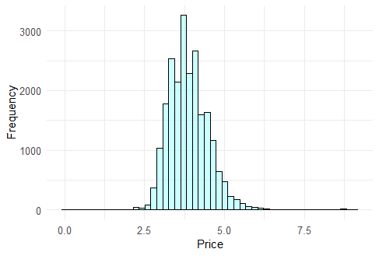
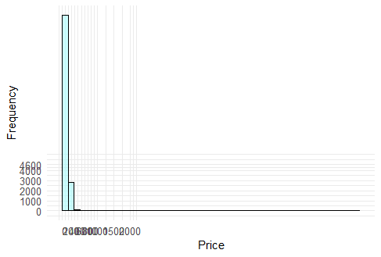
Frequency of price
Right Skewed using price
Normal graph using log of price

Slide 15
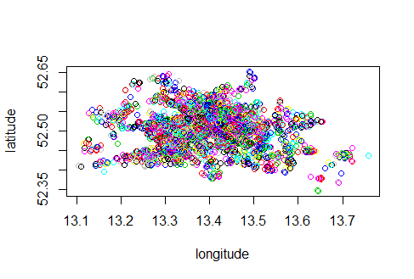
Each listing location color coded by price

Slide 16
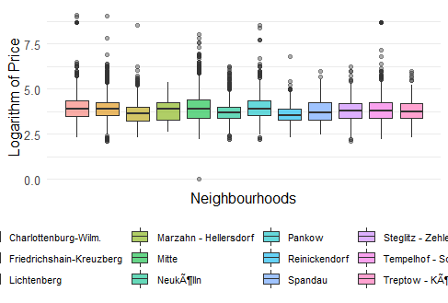
Box plot of log (price) for each neighbourhood.

Slide 17
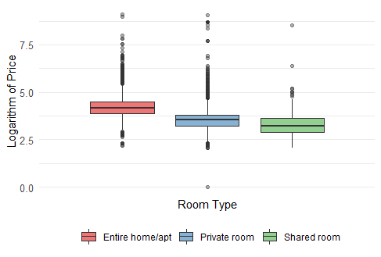
Box plots showing log(price) against room types

Slide 18
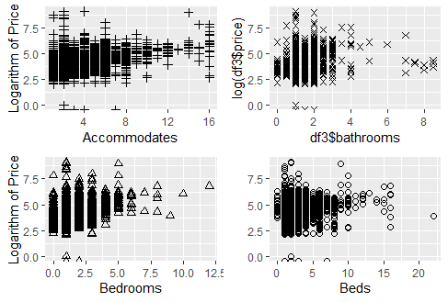
Scatter plots showing variation of data

Slide 19
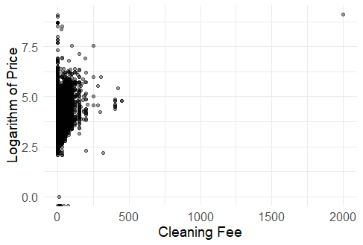
Scatter plot of cleaning fee

Slide 20
Feature Engineering

Slide 21
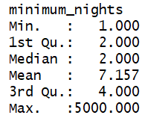
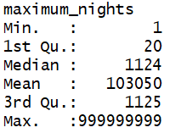
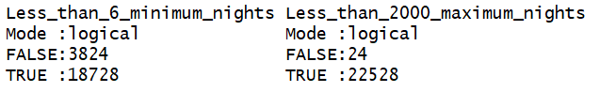
Feature Engineering 1: We can see above data has outliers, hence we converted these columns to Less than 6 minimum nights and less than 2000 maximum nights.

Slide 22
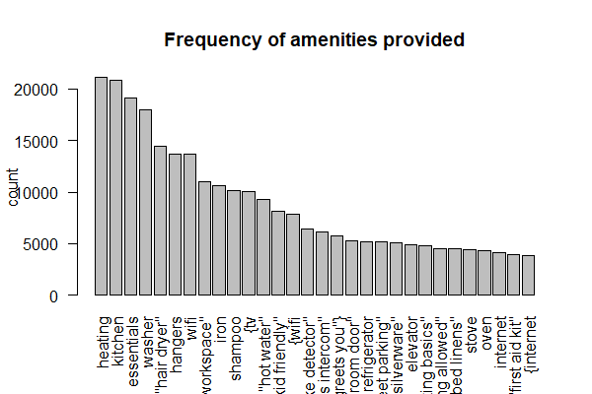
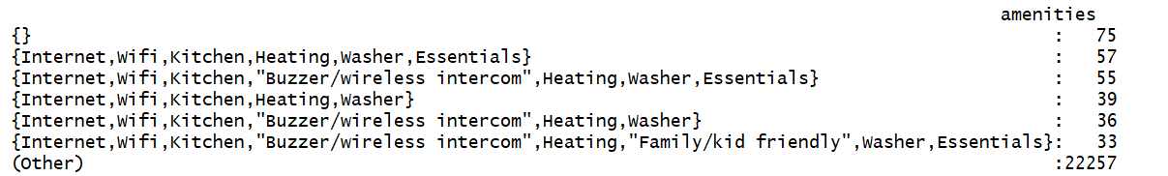
Feature Engineering 2: After calculating frequency of words in amenities variable, we created 5 new variables which were quite unique and not provided by every host.

Slide 23
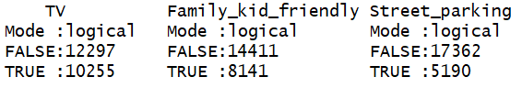
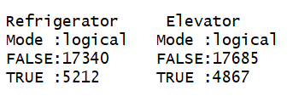
Below are the 5 variables that we selected

Slide 24
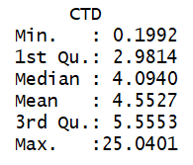
Feature Engineering 3: Distance to Centroid of Berlin
Location is always an important factor in lodging services. To make it more descriptive, We decided to calculate each accommodation's distance to the so-called centroid of Berlin instead of just relying on the neighbourhoods or areas.
We calculated distance using latitude and longitude of each listing from the center latitude (52.5027778) and longitude (13.404166666666667) of Berlin.

Slide 25
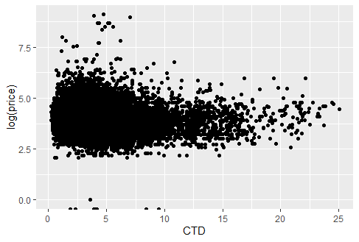
Scatter plot of log(price) and CTD(Distance from the center of Berlin)

Slide 26
Data Modelling

Slide 27
Linear Regression
Data partitioning into 3 sets viz, Train (60%), Valid(20%) and Test(20%)
General Linear Regression model is run using all the predictors against price
Here the resultant adjusted R squared value is 0.04293 which is very low
Looking at the P values of the predictors, the significant variables were chosen for the next model
This model have all the chosen variables from the above model which performed similar
Next we ran Exhaustive Search

Slide 28
Exhaustive Search
After running exhaustive search, we get the following result for adjusted R squared and from it we selected the highlighted ones.
Based on this, we created 3 models with 15, 16 and 17 variables as per the exhaustive search results.
Model 2 with 16 variables performed the best on Test data with RMSE of 197.912

Slide 29
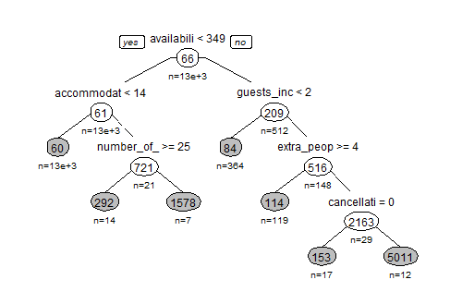
Regression Tree
Regression tree is run using all the predictors against price of the training data
Now the tree is applied on the Test dataset to predict price which gives us an RMSE of 156.297

Slide 30
Conclusion
Regression tree gave better RMSE than Linear regression model
Availability 365, Elevator, TV, CTD, instant bookable variables were important for determining price
Other top features are the number of people the apartment accommodates, other fees such as security deposit or the price for extra people, minimum night stay and bedrooms.

Slide 31
Difficulties Faced
Data cleansing was a tedious task
Feature engineering took a lot of time
Handling several text columns like amenities
Data exploration – price was skewed so had to take log (price)

